Slide 1
FITNESS TRACKER
VISHALINI 7/11/24

Slide 2
OVERVIEW
The Fitness Tracker project uses machine learning to analyze fitness data, recognizing patterns and providing personalized insights to help users improve their health and achieve their fitness goals. By turning raw activity data into meaningful information, it empowers users to make data-driven decisions for a healthier lifestyle.

Slide 3
WORK FLOW
Data Import and Initial Check
Data Cleaning
Outlier Detection and Handling
Exploratory Data Analysis (EDA)

Slide 4
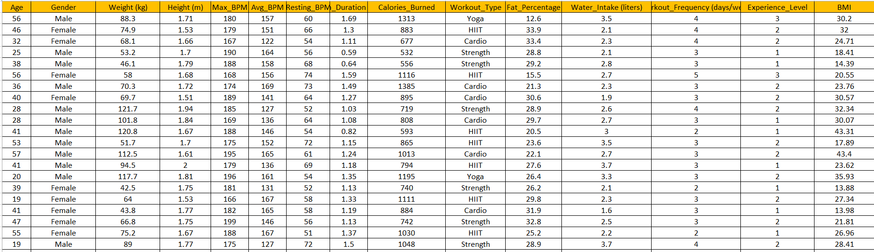
DATA SET

Slide 5
Data understanding
Number of Columns: 15
Number of Rows: 973
NUMBER OF COLUMNS : 15 DATA TYPE : INTIGER ,FLOAT,OBJECT

Slide 6
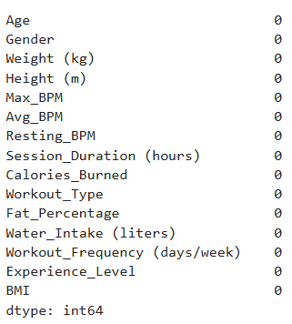
EXPLOPRATION

Slide 7
MISSING VALUE
There is no missing value

Slide 8
Outlier Handling
Removal of Outliers Transformation Capping

Slide 9
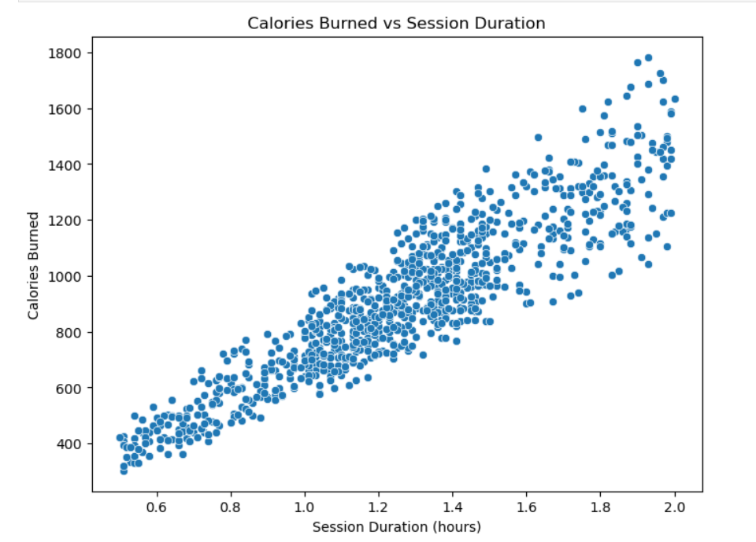
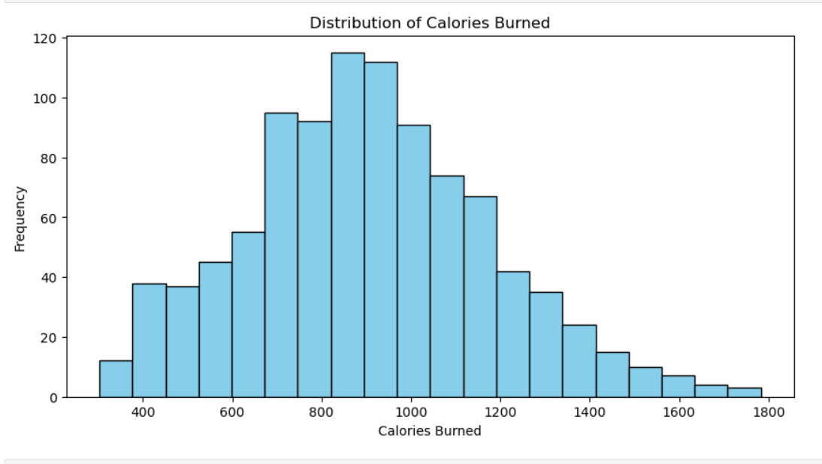
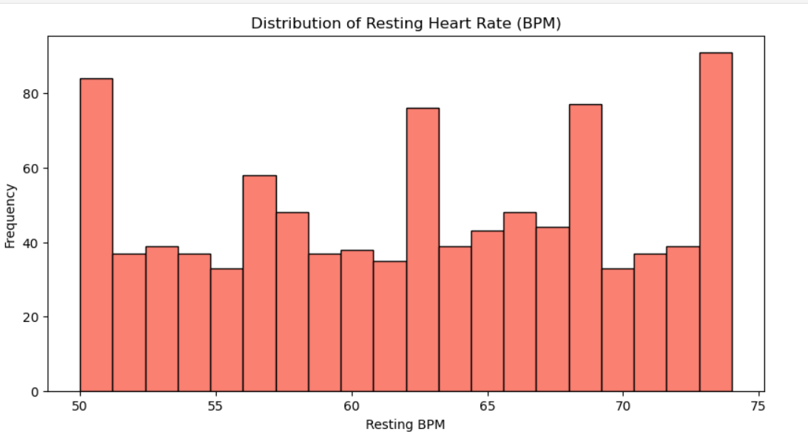
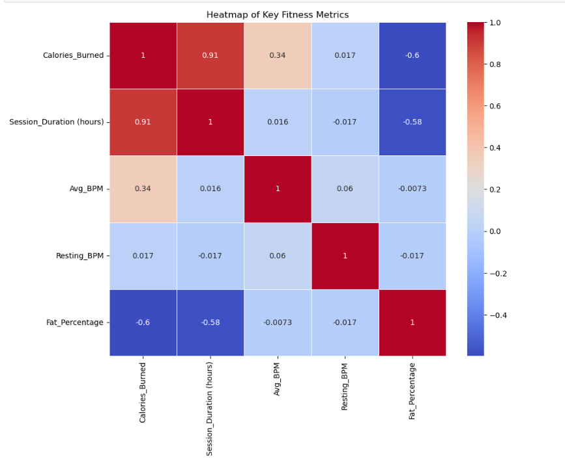
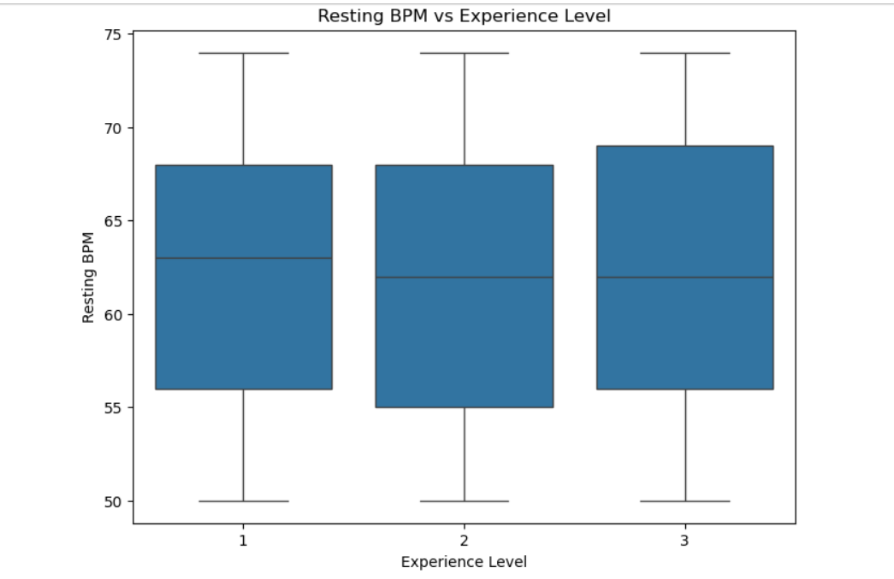
Data Visualization

